Slide 1
VeoRide E-Scooter Transportation
UMD DC21 Team 29 Savia, Irfaan, Tanishq, and William
Mentor: Derek Paley
February 27, 2021

Slide 2
Outline of presentation
01.
Predictions
Results
03.
02.
Methods
Conclusion
04.
Hypothesis of how VeoRide scooters help supplement campus transportation
Results from the data analysis
The data sets and methods used to test hypothesis and conduct analysis
Summary of findings and recommendations for DOTS

Slide 3
The majority of scooter rides occur on campus.
E-scooter riders avoid traveling in car or bus traffic.
E-scooters are also utilized for recreation.
Predictions

Slide 4

Methods
Frequency Distributions
Spatial Distributions
Boundary Analysis
OpenStreetMap
Google Maps API
Python libraries
We classified rides by start and end location
Type A: start and end on campus
Type B: start on and end off campus
Type C: start off and end on campus
Type D: start and end off campus

Slide 5
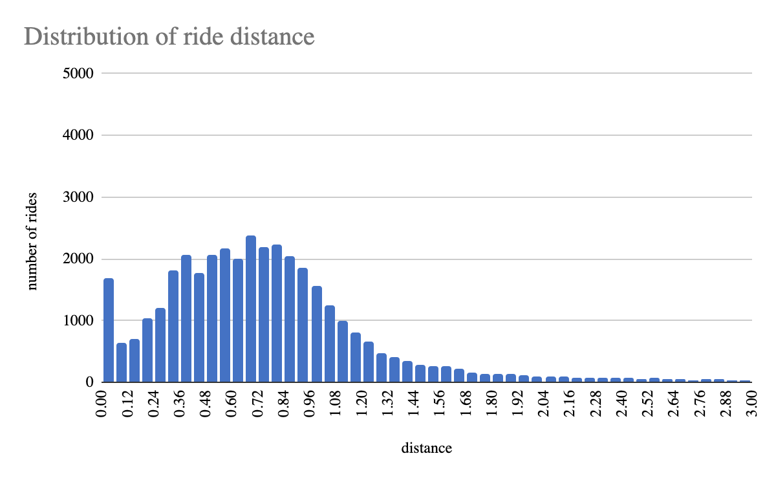
Most rides are under one mile
20% of rides are more than one mile

Slide 6
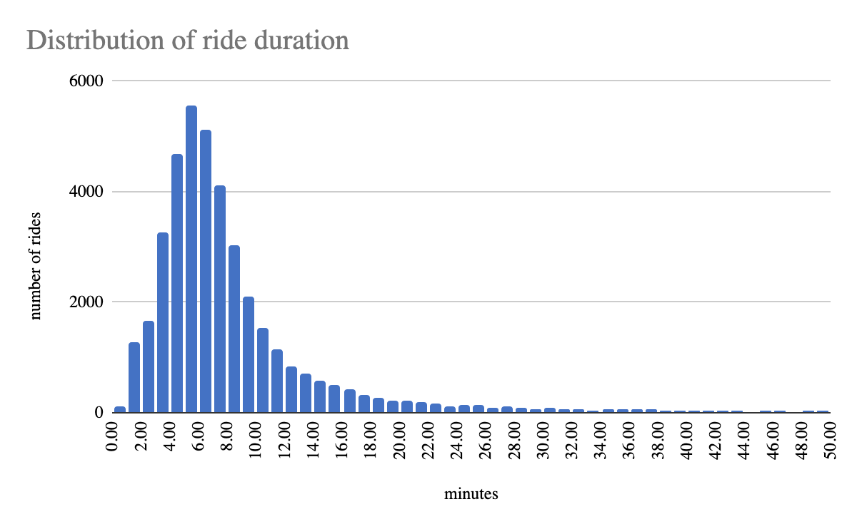
The most frequent duration is 5 minutes
20% of rides are more than 10 minutes

Slide 7
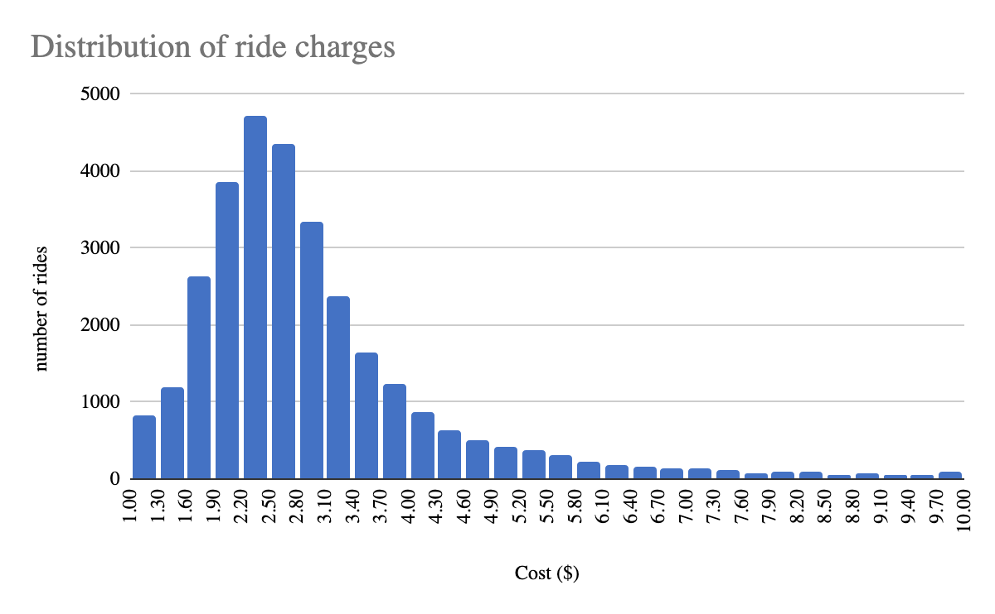
Most rides cost under $5
Customers spent a total of $236,477 in two months

Slide 8
Campus, commercial, and residential boundaries
Only 4% of rides violated the VeoRide boundary
Notes:
William TODO

Slide 9
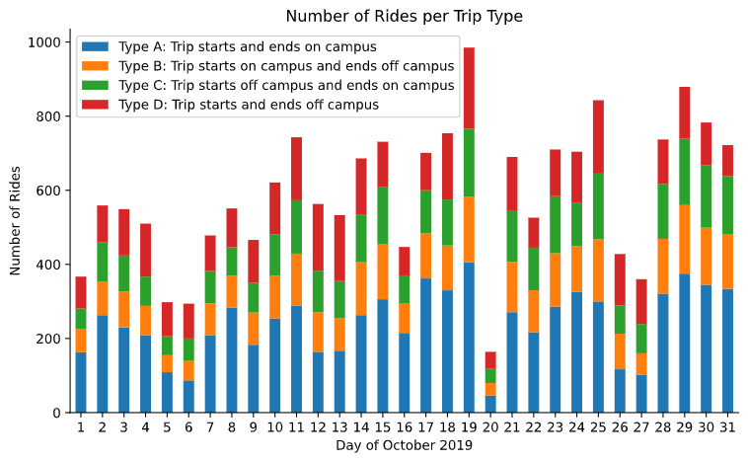
Largest portion of rides start & end on campus
Trend is different on weekends and weekdays
Home football game against Indiana 10/19/19

Slide 10
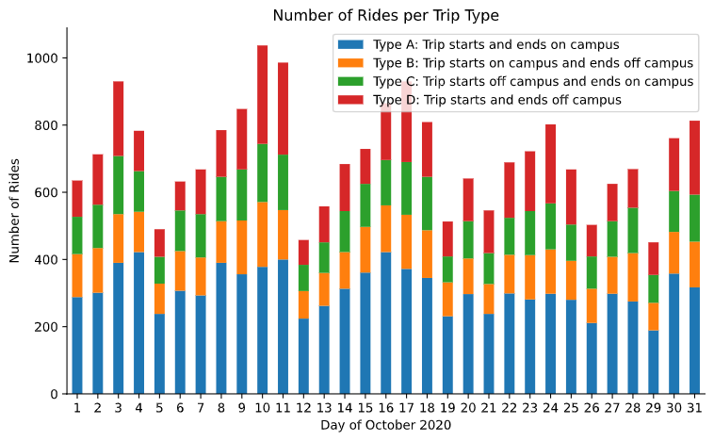
October 2020 shows increased usage
Weekend rides were more prevalent than 2019

Slide 11
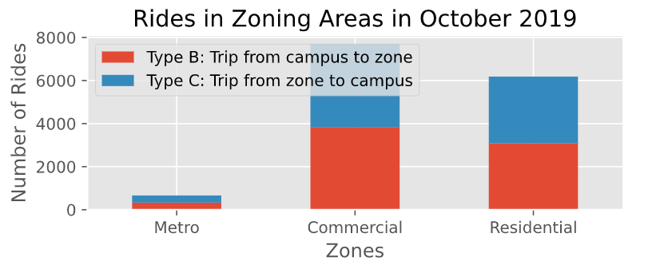
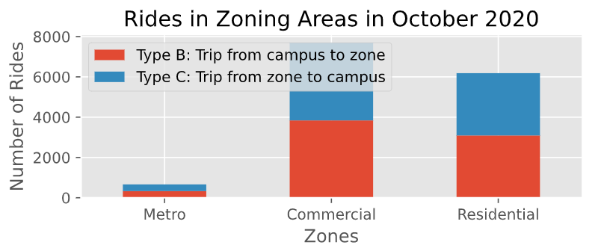
Off-campus rides link to commercial and residential zones more than the Metro

Slide 12
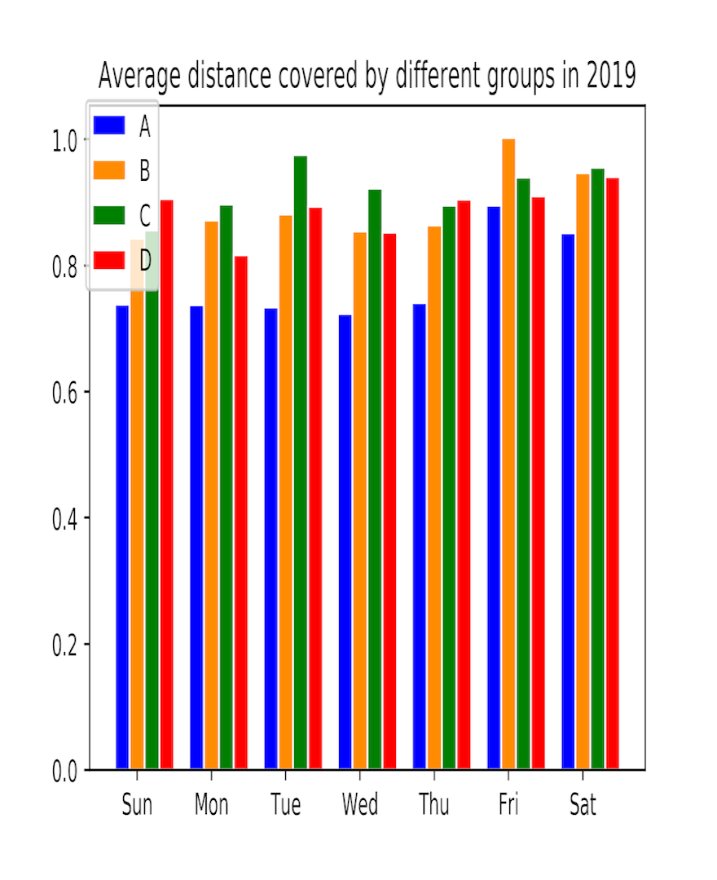
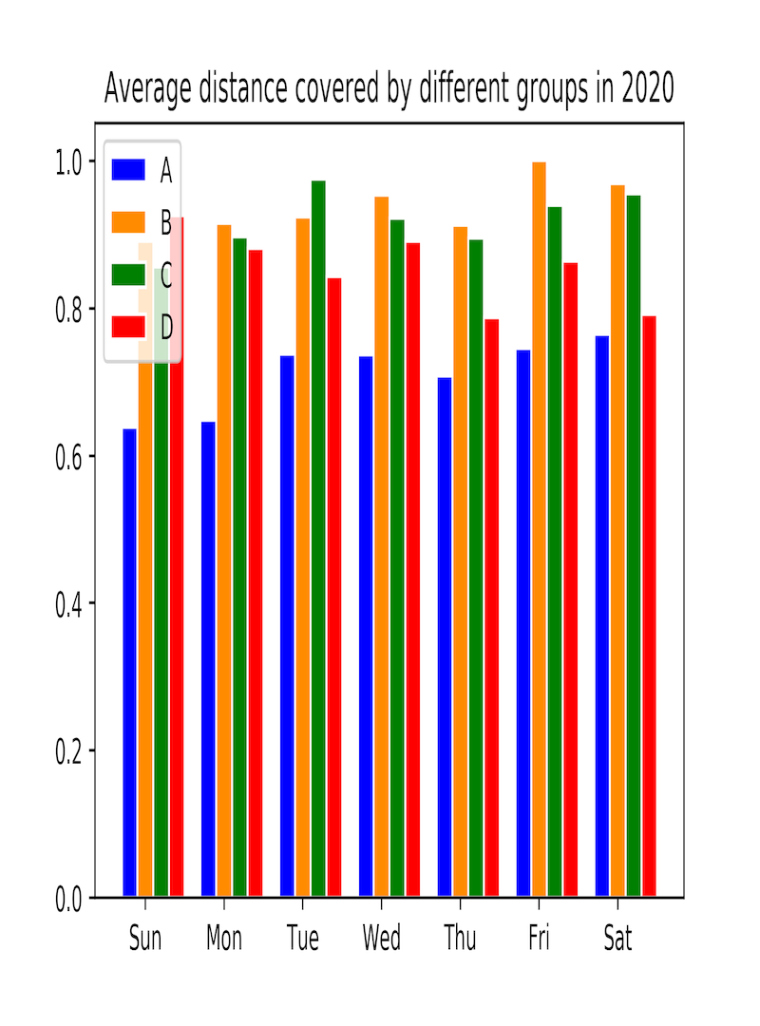
Average distance travelled was shorter for on-campus rides

Slide 13
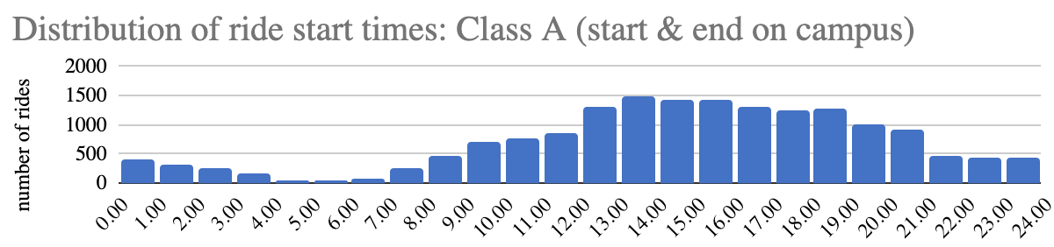
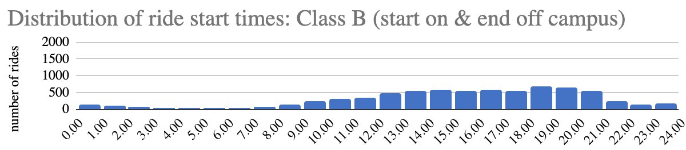
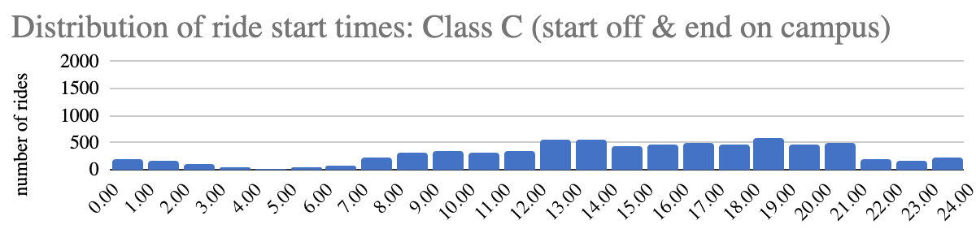
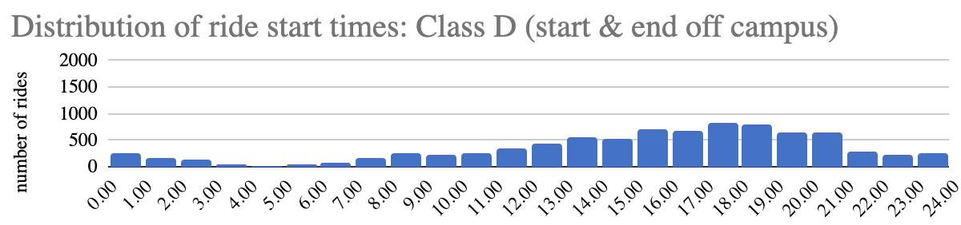

Slide 14
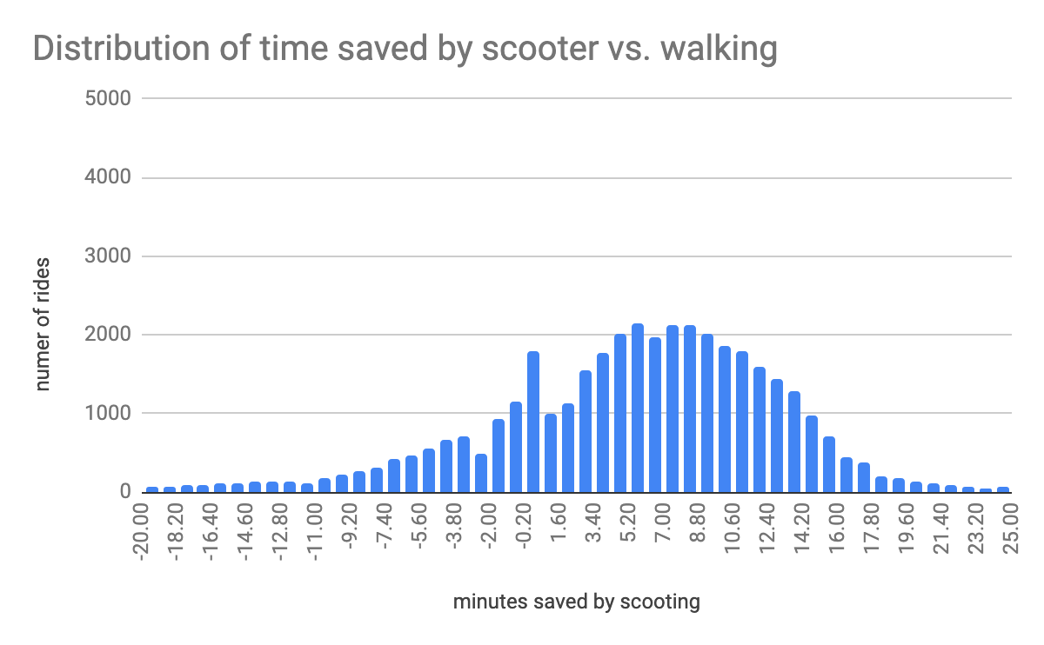
Scooting saved time compared to walking
We used the Google Maps API to compute walking times
Scooter rides that lasted longer than walking may have been for recreation

Slide 15
 | Travel time by bus (mins) | Travel time by walking (min) | Travel time by e-scooter(mins)
Regents Drive ↔ CP Metro | 11 | 24 | 9
Stamp ↔ University View | 15 | 15 | 6
Stamp ↔ University Club Apartments | 15 | 18 | 8
Stamp ↔ The Varsity | 16 | 12 | 4.5
Stamp ↔ Leonardtown CC | 17 | 14 | 8
The Enclave ↔ Mazza Grandmarc | 9 | 20 | 14
Notes:
Riding scooters saves a significant amount of time compared to taking the bus for many trips across campus!

Slide 16
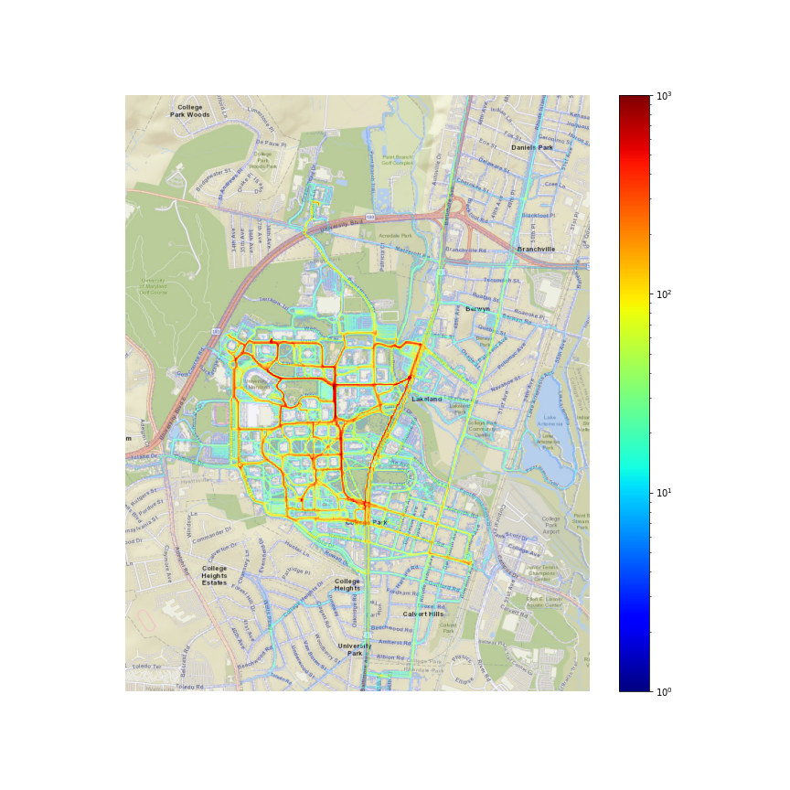
Scooter rides on and around the campus area

Slide 17
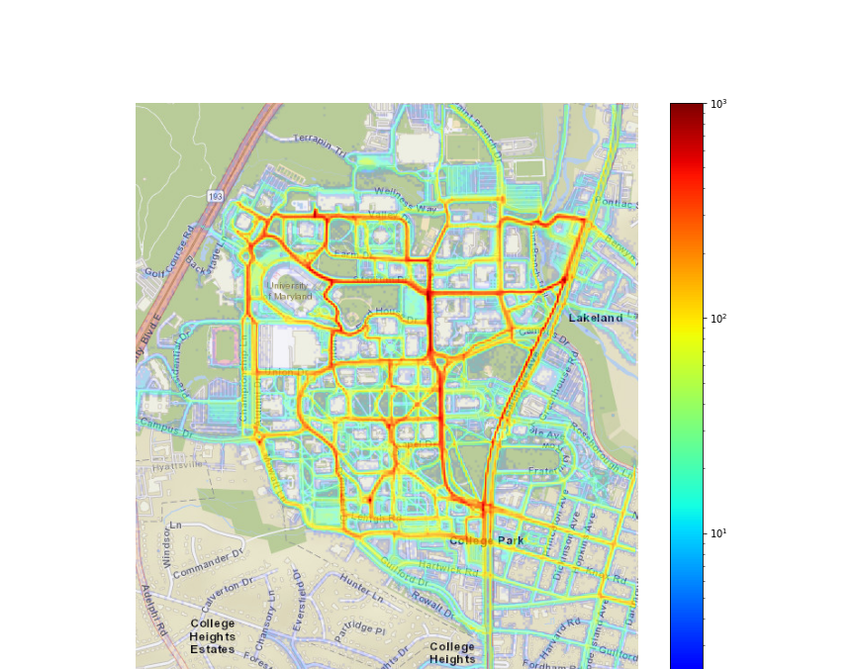
Most commonly used scooter paths in campus area
Notes:
A few main arteries

Slide 18
Most commonly used access points
Notes:
Most common access points are the pedestrian bridges in the northeast
And the southern entrance onto Baltimore ave.

Slide 19
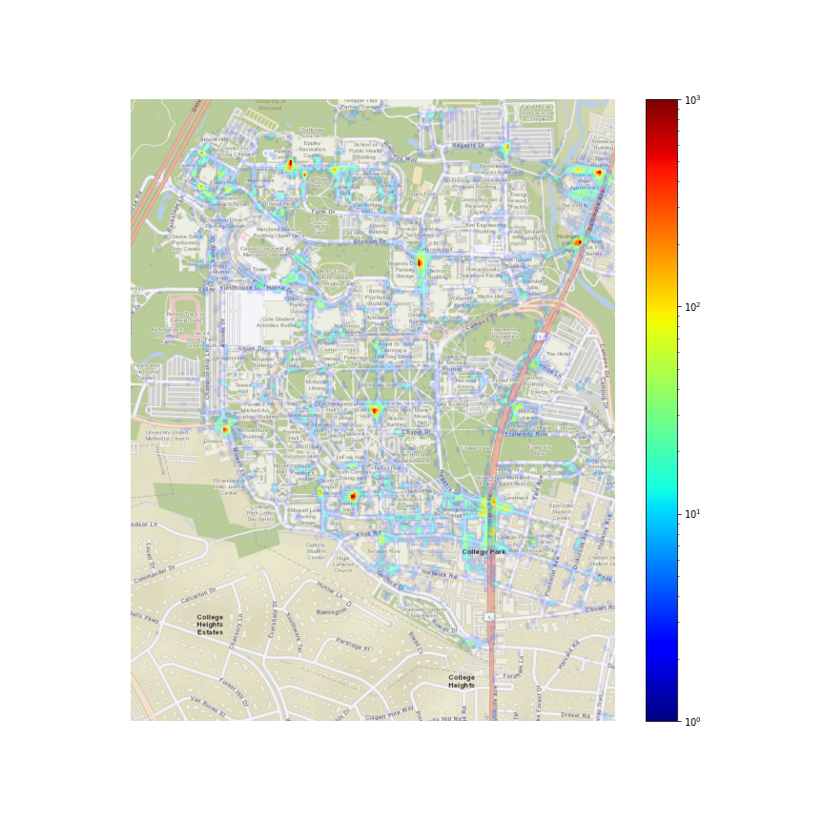
Distribution of start & end locations

Slide 20
Parking lot/garage locations
Notes:
Major Parking nodes on Campus
Suggests reliable availability is NB driving factor for adoption

Slide 21
Residential areas

Slide 22
Dining halls, shops, and rec facilities
Notes:
Stamp is perhaps somewhat less than expected?

Slide 23
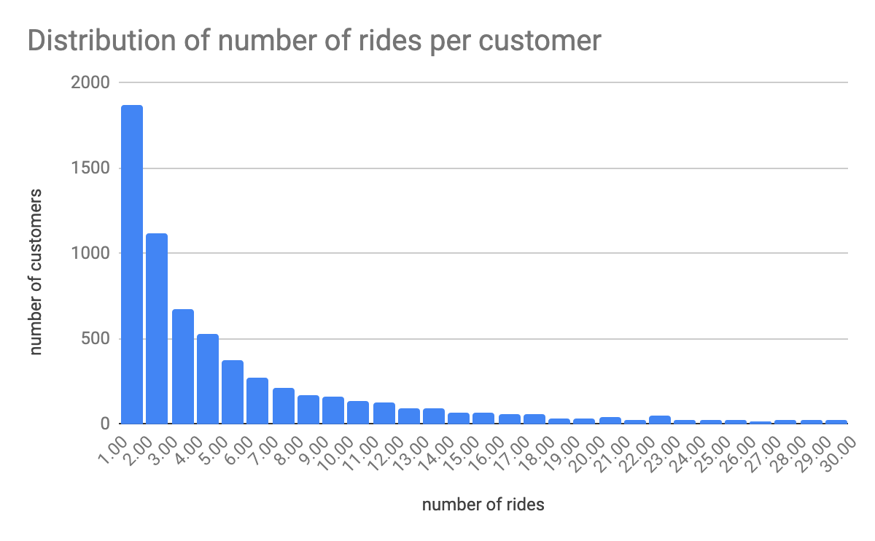
Most customers only rode a few times
There were 6,605 customers in two months. 150 averaged 0.5+ rides/day; 15 averaged 2+ rides/day

Slide 24
Conclusion
Summary of findings
Recommendations for DOTS
The largest portion of rides started and ended on campus
Some riders appeared to be using scooters for recreational purposes
Scooting saves time compared to walking or taking the bus
Fine-grained density analysis would inform where to install bike lanes
Reliable access to scooters is improved by larger parking hubs
Challenges remain to increase adoption and usage
Notes:
Quality of Life:
Through our data analysis, we discovered that riding scooters saves time compared to taking the bus in many locations across campus. Adopting more scooters would improve the quality of life by providing easier access to campus locations while having a fun time.
Scooters reduce congestion levels compared to cars which increases safety and decreases travel times for other road users too
Scooters don’t require vast parking lots and so land can be used more efficiently whether for buildings or green spaces
Scooters are quiet and don’t emit air pollution, which is beneficial to both students’ health and the environment.
We found that:
The data suggests that a good portion of riders utilize scooters for recreational purposes.
Most riders are from within campus.
Something about ‘scooter riders avoid traveling in car or bus traffic e-scooter riders avoid traveling in car or bus traffic’ [what to say for this??]

Slide 25
VeoRide E-Scooters: How to increase adoption of e-scooters in College Park
Why?
How?
Fine-grained density analysis would inform where to install bike lanes
Reliable access to scooters is improved by larger parking hubs
Increase incentives for regular use
Promotions to help students understand the benefits of e-scooters and safe routes.
E-scooters are efficient and non polluting
Increased adoption would reduce congestion and the need for large parking lots
Analysis showed that e-scooters actually saved time compared to bussing or walking
Notes:
Quality of Life:
Through our data analysis, we discovered that riding scooters saves time compared to taking the bus in many locations across campus. Adopting more scooters would improve the quality of life by providing easier access to campus locations while having a fun time.
Scooters reduce congestion levels compared to cars which increases safety and decreases travel times for other road users too
Scooters don’t require vast parking lots and so land can be used more efficiently whether for buildings or green spaces
Scooters are quiet and don’t emit air pollution, which is beneficial to both students’ health and the environment.
We found that:
The data suggests that a good portion of riders utilize scooters for recreational purposes.
Most riders are from within campus.
Something about ‘scooter riders avoid traveling in car or bus traffic e-scooter riders avoid traveling in car or bus traffic’ [what to say for this??]

Slide 26
Other Datasets Used in Analysis
DOTS Bus Schedule
City of College Park | Complete Streets Policy and Implementation Plan
VeoRide Geofence and Restricted Parking Zones

Slide 27
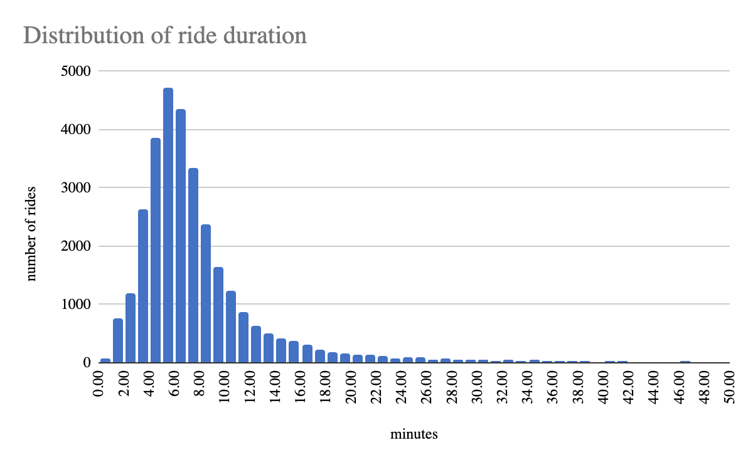
Average speed is under 10 mph

Slide 28
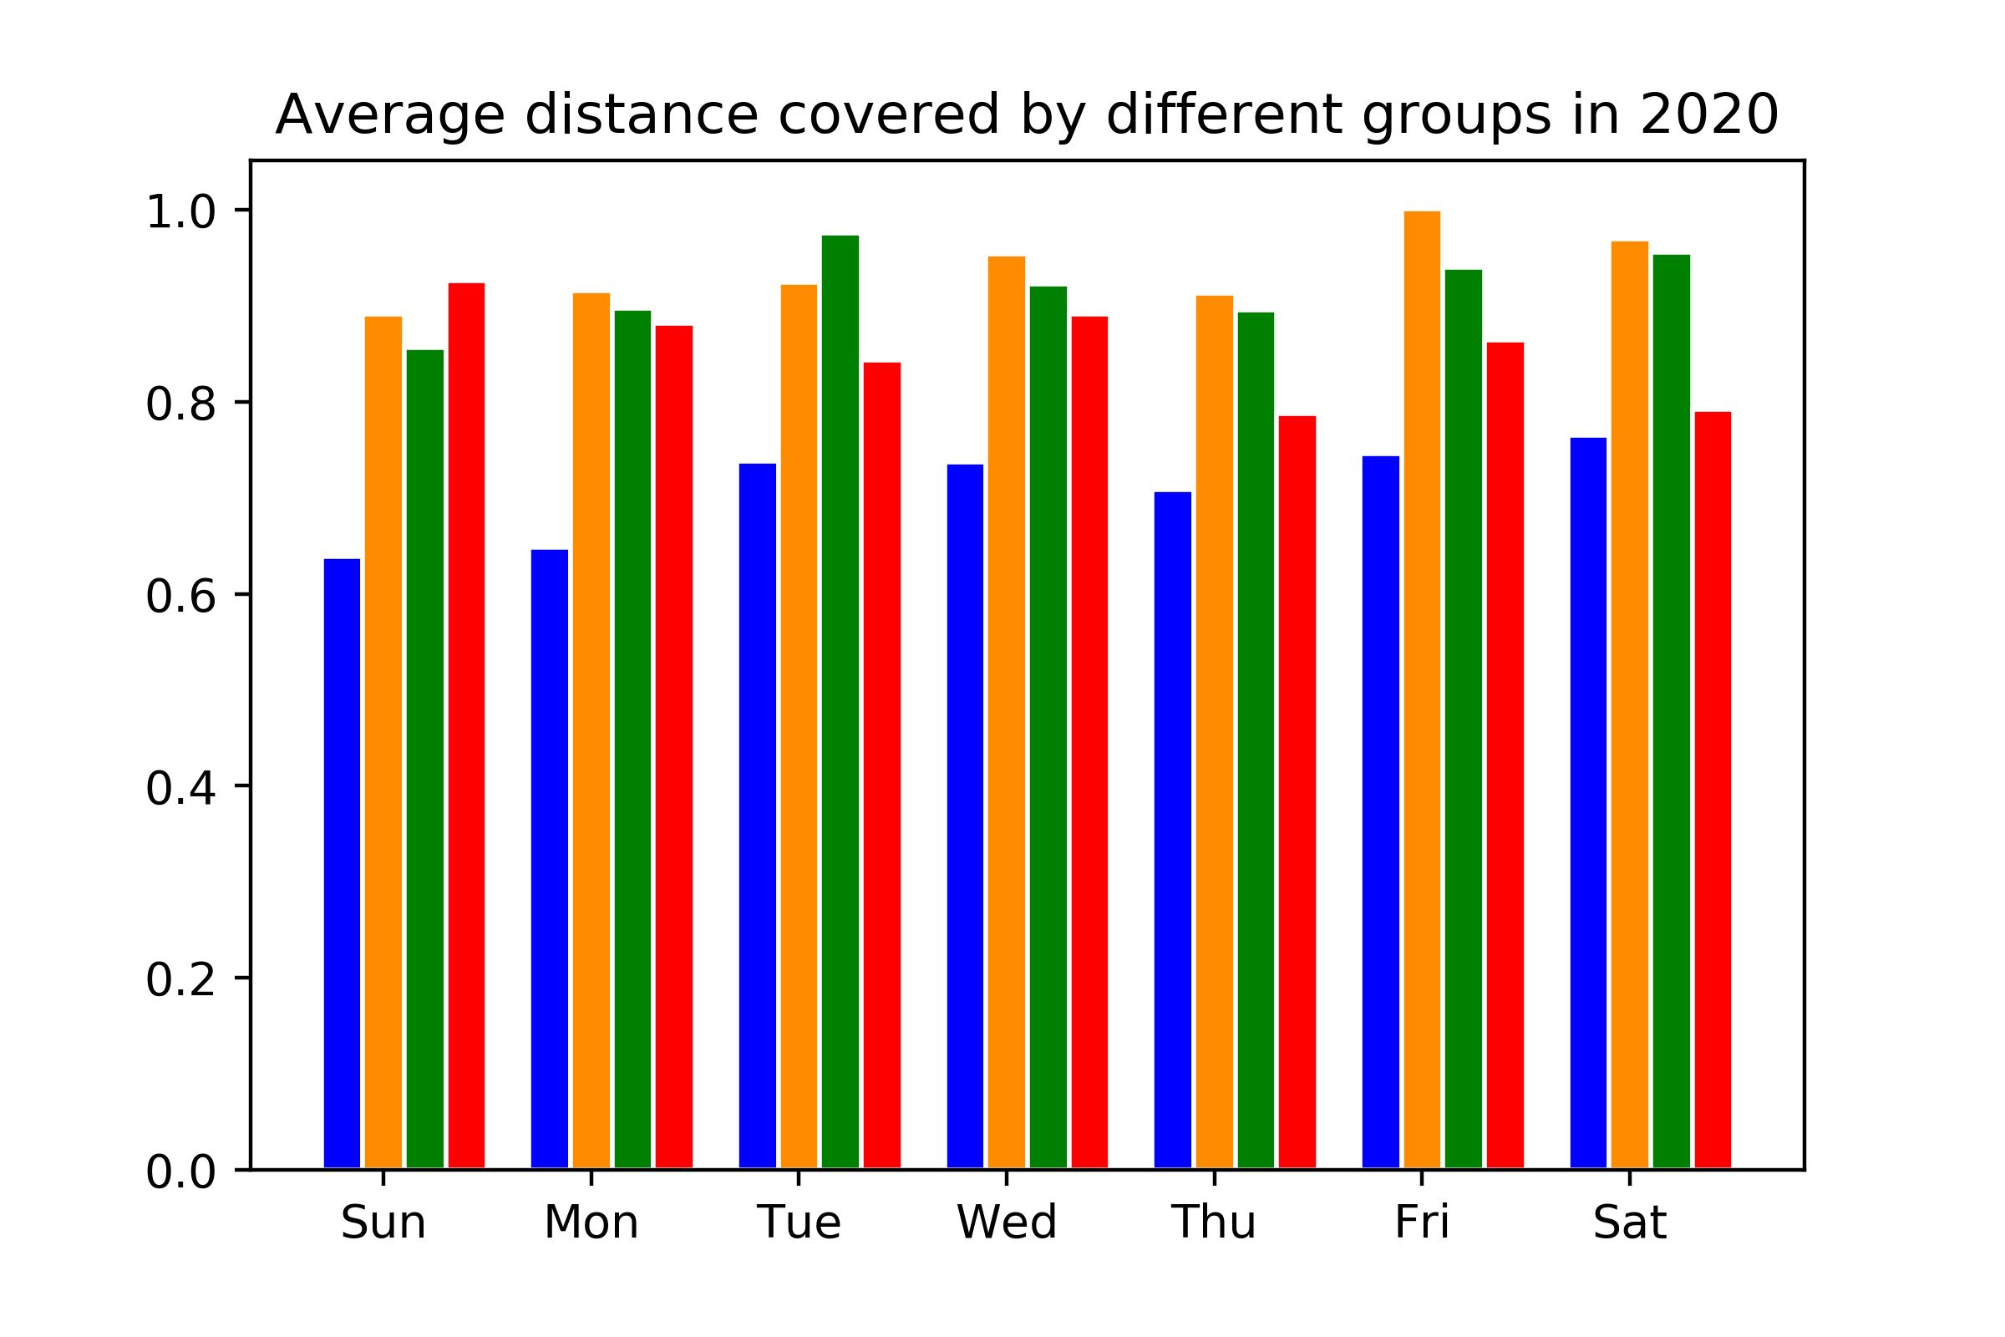

Slide 29
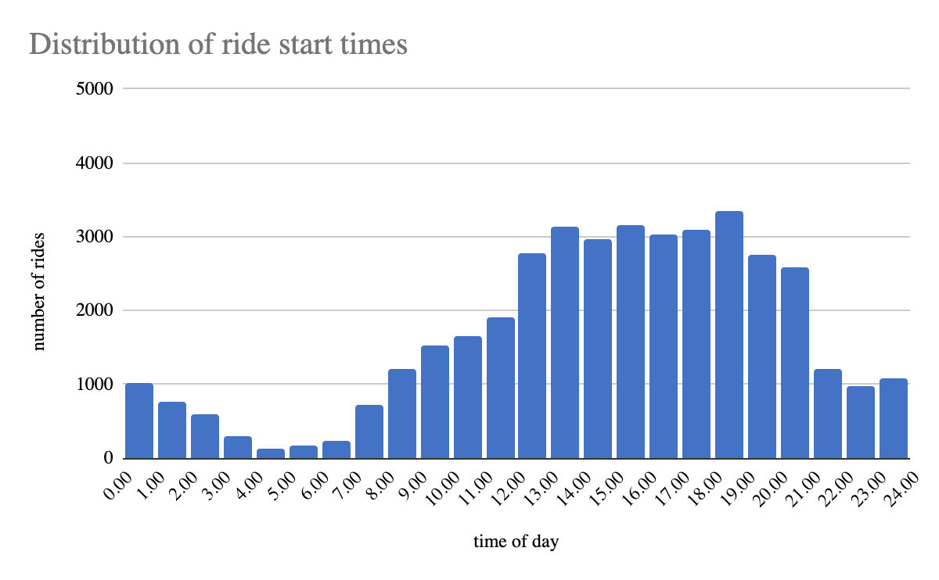
The most rides are between 12:00-8:00 PM
Substantial overnight usage not for commuting
Notes:
Sudden drop at 9pm likely due to restrictions to unlocking scooters on campus after 9pm, likely there still is demand! Cut off too early?

Slide 30
Conclusion
3.
2.
Summary of findings:
Notes:
Quality of Life:
Through our data analysis, we discovered that riding scooters saves time compared to taking the bus in many locations across campus. Adopting more scooters would improve the quality of life by providing easier access to campus locations while having a fun time.
Scooters reduce congestion levels compared to cars which increases safety and decreases travel times for other road users too
Scooters don’t require vast parking lots and so land can be used more efficiently whether for buildings or green spaces
Scooters are quiet and don’t emit air pollution, which is beneficial to both students’ health and the environment.
We found that:
The data suggests that a good portion of riders utilize scooters for recreational purposes.
Most riders are from within campus.
Something about ‘scooter riders avoid traveling in car or bus traffic e-scooter riders avoid traveling in car or bus traffic’ [what to say for this??]

Slide 31
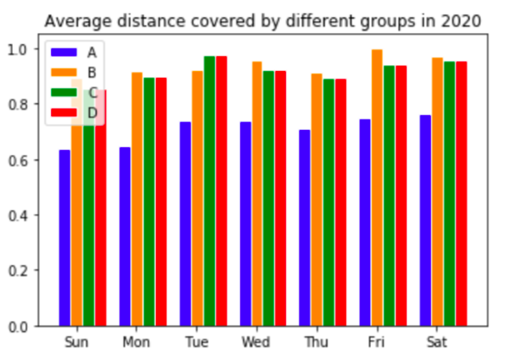

Slide 32
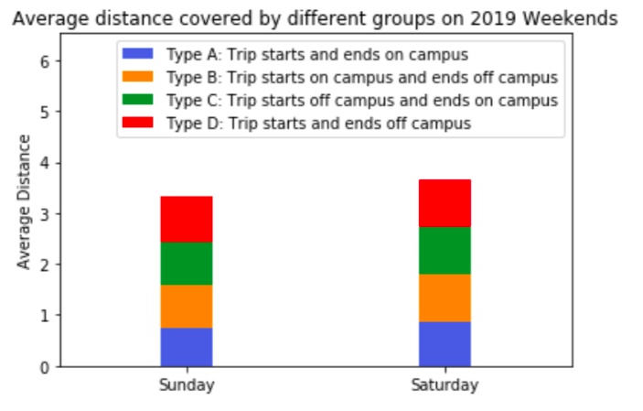

Slide 33
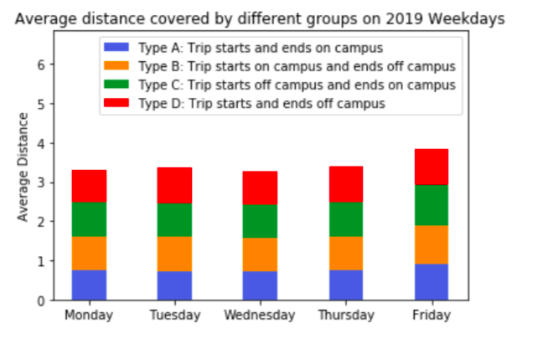

Slide 34
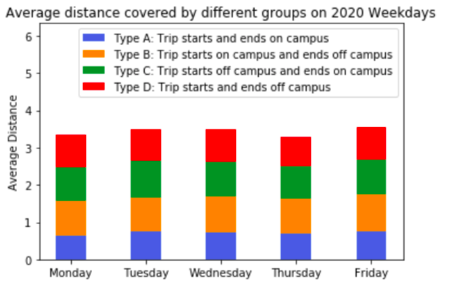

Slide 35
